Slide 1

Introduction to SAS

Slide 2
Introduction to SAS Language

Slide 3

Instructor
Economist , TERI University
https://welcomedata.wordpress.com/
https://www.linkedin.com/in/sunakshibhatia

Slide 4
What is SAS?
SAS (Statistical Analysis System
Software suite developed by SAS Institute for advanced analytics, business intelligence, data management, and predictive analytics
Developed at North Carolina State University from 1966 until 1976, when SAS Institute was incorporated.
Further developed in the 1980s and 1990s with the additional statistical procedures and components

Slide 5
Components of SAS
Currently, SAS has more than 200 components, some of them are –
Base SAS – Basic procedures and data management
SAS/STAT – Statistical analysis
SAS/GRAPH – Graphics and presentation
SAS/OR – Operations research
SAS/ETS – Econometrics and Time Series Analysis
SAS/IML – Interactive matrix language

Slide 6
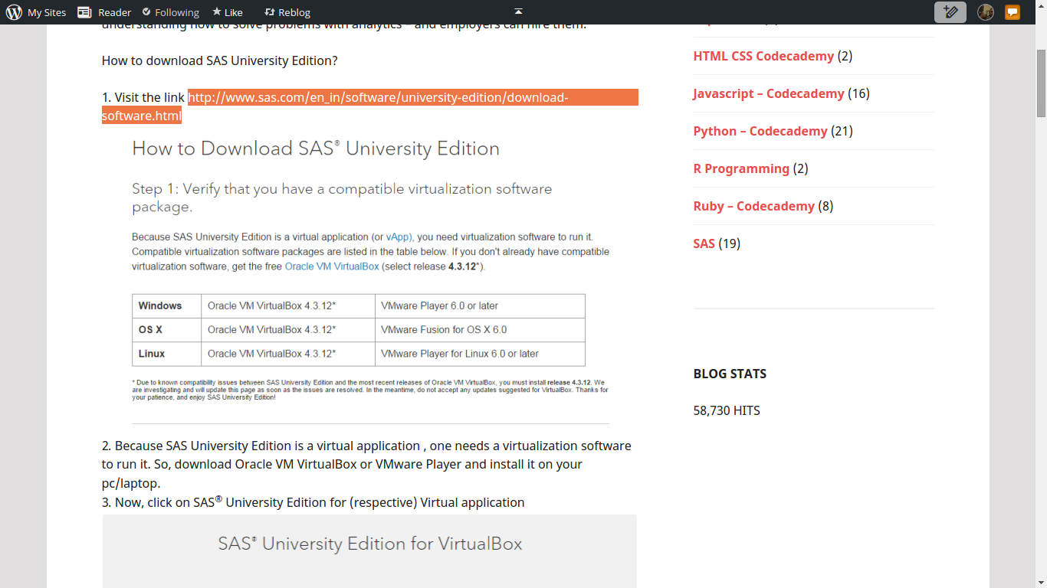
SAS University Edition
http://www.sas.com/en_in/software/university-edition/download-software.html
https://welcomedata.wordpress.com/2015/03/13/downloading-and-installing-sas-university-edition/

Slide 7
SAS Interface
Code Editor where we write and modify mode
Log is a record of everything that we do in SAS session or SAS program :-
Program statements identified by line numbers
Messages that begin with NOTE, INFO, WARNING, ERROR, or an error number
Process time
Result displays printed output

Slide 8
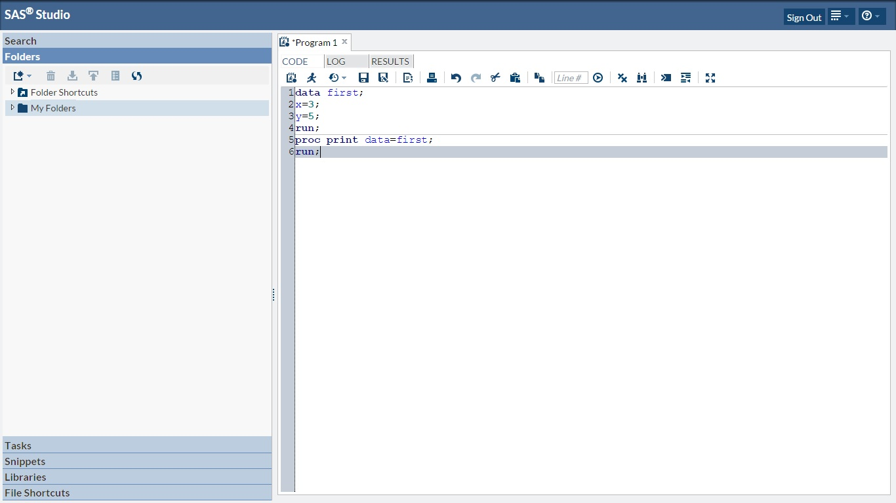
SAS Code Editor

Slide 9
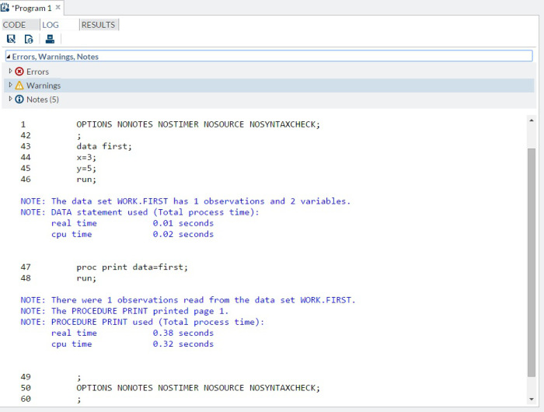
SAS Log

Slide 10
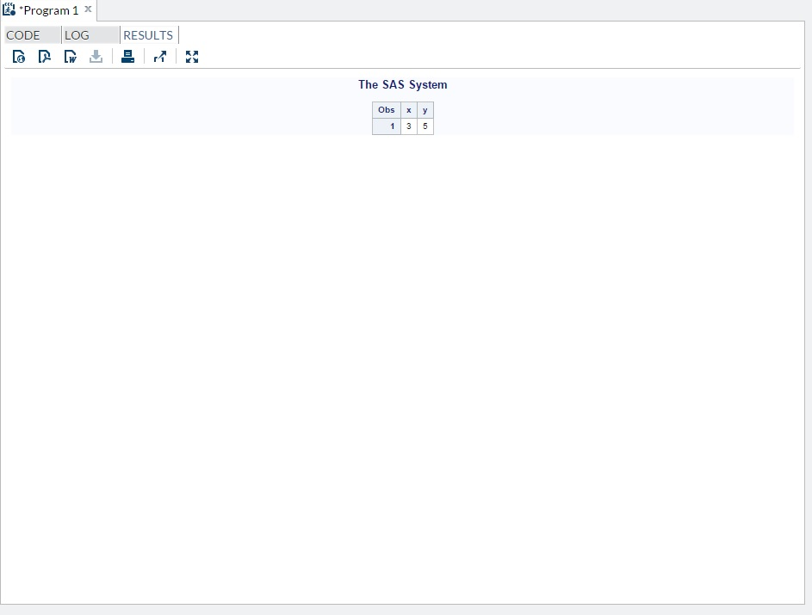
SAS Result

Slide 11
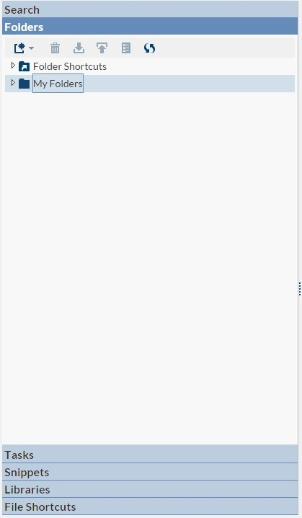
SAS Explorer
All libraries, folders , files that include data, saved code and saved output can be found here

Slide 12
SAS Language
SAS program consists of SAS Statements
Each SAS Statement end with a semi-colon (;)
Basic SAS Statements are :
Data Step
Proc Step
DATA Step – used to create or modify data sets
PROC Step (Procedure) - pre-written rules that analyze and process data in a SAS dataset and then produce a report

Slide 13
SAS Language
A SAS program can consist of a DATA step or a PROC step or any combination of DATA and PROC steps.
Data Step and Proc Step are followed by Run Statement.
SAS statements are free-format –
they can begin and end anywhere on a line
one statement can continue over several lines
To Comment use (/*Comment*/)

Slide 14
Class Assignment
Create a cheat sheet for yourself of the code that you run in the class.
Add short comments for each program or each new step.
Submit the cheat sheet at the end of the class.

Slide 15
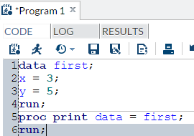
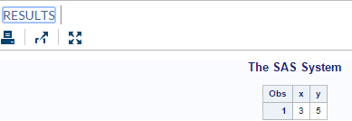
Create Temporary Data set
i. There are six SAS statements.
ii. DATA step – creates a new dataset called first.
iii. PROC step – prints/displays that dataset in the results/output window.

Slide 16
PROC Step
Proc PRINT
Proc DATASETS
Proc CONTENTS
Proc SORT
Proc FREQ
Proc MEANS
Proc UNIVARIATE
Proc CORR

Slide 17
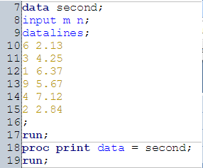
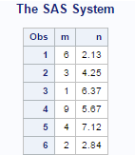
Create Temporary Data set
Input Statement –
Input variable names,
Describes arrangement of values in the input data record and assigns
Datalines/Cards Statement indicates that existence of data lines below
In the above program:
i. There are seven SAS statements;
ii. The INPUT statement defines the variables to be read in each line of data.
iii. The DATALINES statement indicates to SAS that DATA step statements are completed and the next line contains real data.
iv. Notice that the lines of data do not end in a semicolon.

Slide 18
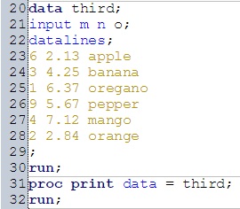
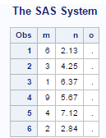
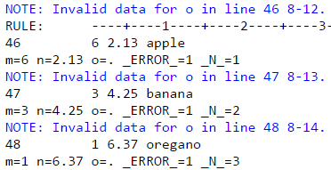
Create Temporary Data set
Missing values for Character variable o?
Let us check Log for errors

Slide 19
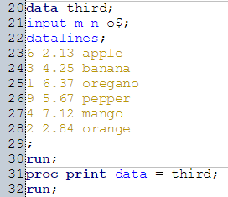
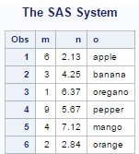
Create Temporary Data set
For character variable add “$” after variable name in Input statement

Slide 20
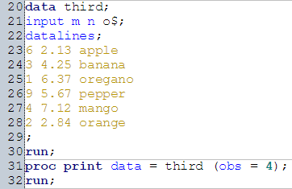
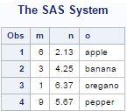
SAS Options
Here, PROC step prints only the first 4 observations of the data set third

Slide 21
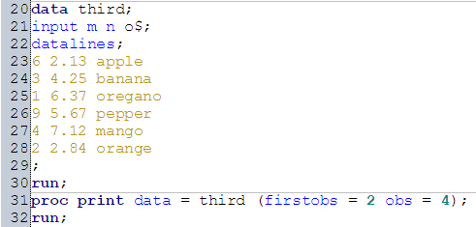
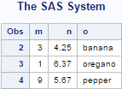
SAS Options
Here, PROC step prints the data set third beginning with observation 2 till observation 4

Slide 22
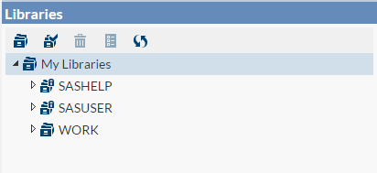
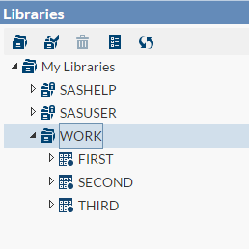
SAS Libraries
Permanent Libraries (Default) –
SASHELP – contains sample data sets
SASUSER – stores personal files
Temporary Library –
WORK – stores files only for current session

Slide 23
SAS Files
Rules for data set names –
i. 1 to 32 characters
ii. must begin with an alphabet A-Z(uppercase or lowercase) or underscore
ii. can continue with any combination of alphabets, numbers or underscores
Referencing SAS Files
Two-Level Names
To reference a permanent SAS data set in your SAS programs, we use a two-level name
library name and the filename, or data set name:
libref.filename

Slide 24
PROC Datasets
PROC DATASETS is used
to list, copy, remove, or delete SAS files.
to change variable information such as name, format, informat and label.
PROC Datasets does not require RUN Statement

Slide 25
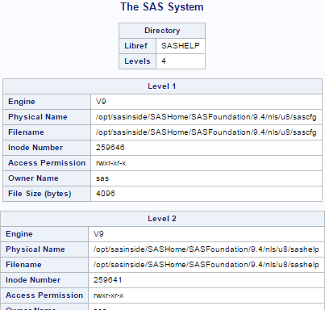
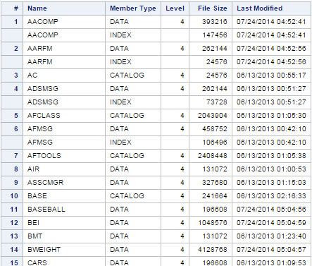
PROC Datasets
The SAS log gives the name of all SAS datasets in the library called SASHELP

Slide 26

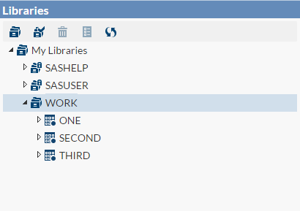
PROC Datasets – CHANGE Statement
In the following program, we change the name of dataset first to one using CHANGE Statement.

Slide 27


PROC Datasets – DELETE Statement
In the following program, we delete dataset one using DELETE Statement.

Slide 28


Create data set using existing dataset
Use SET Statement and create a temporary data set for use in current session from an existing data set
Print the new data set using PROC Print
Try and see what the following program will do

Slide 29
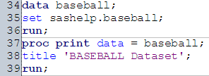
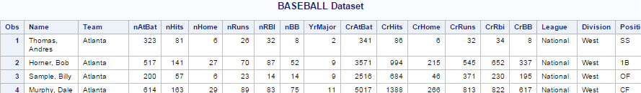
PROC Print – TITLE
As the name suggests, TITLE Statements adds Title while printing the output.

Slide 30
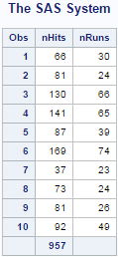
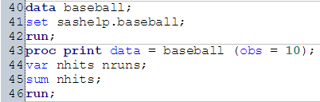
PROC Print – SUM
To generate Column totals use SUM Statement within PROC Step

Slide 31
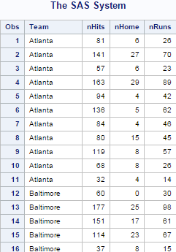
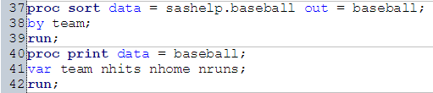
PROC Sort
Here, PROC Sort is used to create a sorted dataset in ascending order according to team variable.

Slide 32
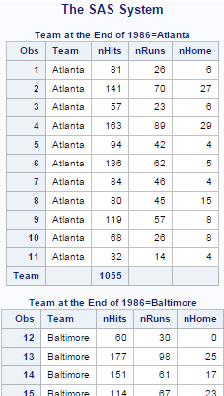
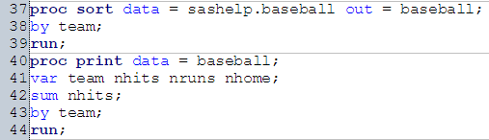
Calculate Subtotals
Here, we calculate and print Subtotals for nhits sorted by variable team.

Slide 33
PROC Contents
PROC Contents -
provides information for SAS datasets or libraries
it gives the name of the dataset or library, the location, when it was created, the host that created it, and the time of the last modification.
For datasets it also provides the number of observations in the dataset, and attributes for each variable

Slide 34
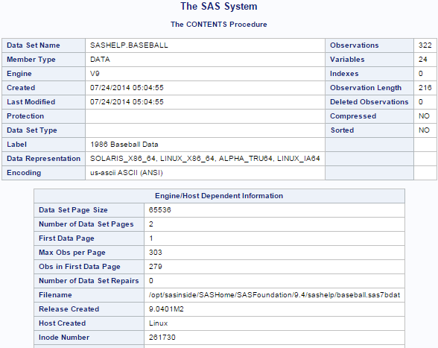
PROC Contents
The following program requests information for sashelp.baseball dataset using PROC Contents.

Slide 35
PROC Freq
PROC FREQ –
Counts the number (frequency) of occurrences of each variable(both character and numeric).
Gives statistics from the data
Produces one- way to n-way frequency and cross-tabulation tables.
Produces printed output by default.
Lists each variable value along with the frequencies and percentages.

Slide 36

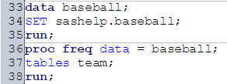
PROC Freq
The following program demonstrates the
simplest form of PROC FREQ and produces the output
The output of this program is too long for our purpose to include here.
Add TABLES Statement to limit the output for only one variable and create a one-way frequency table

Slide 37
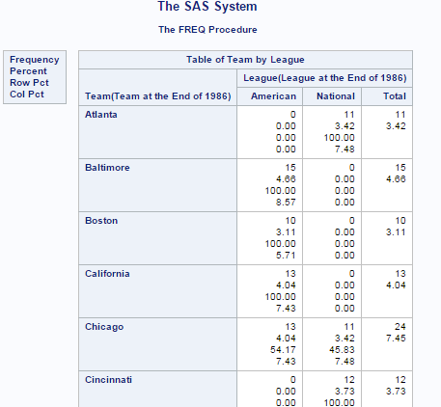
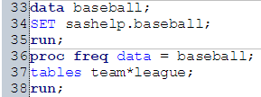
PROC Freq
Create two-way cross-tabulation tables :
In the TABLES statement, state the variable names separated by asterisk

Slide 38
PROC Means
PROC MEANS –
produces statistics for numeric variables.
produces printed output by default
computes N, MEAN, STD, MIN and MAX by default
similar to PROC SUMMARY however, PROC SUMMARY does not produce a printed output by default.

Slide 39

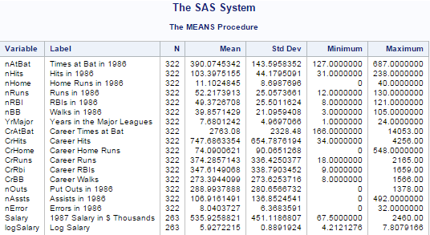
PROC Means
The following shows simplest use of PROC MEANS procedure.

Slide 40
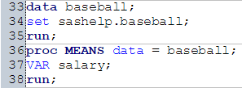
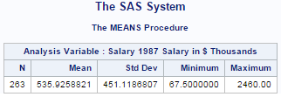
PROC Means – VAR
VAR statement –
selects specified variable ,
Identifies the analysis variables and their order in the output.

Slide 41
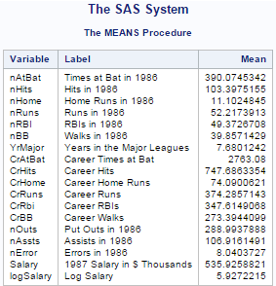

PROC Means – Statistic
To obtain a specific statistic you must state it in the PROC MEANS statement.

Slide 42
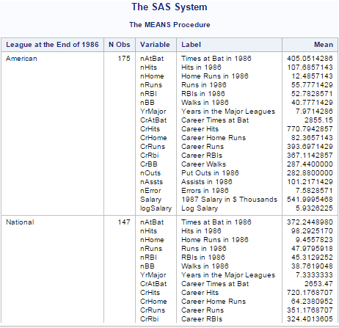
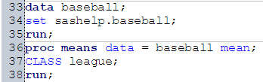
PROC Means – Class
The CLASS statement assigns variables used to form subgroups.
CLASS variables can be either numeric or character.

Slide 43
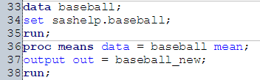
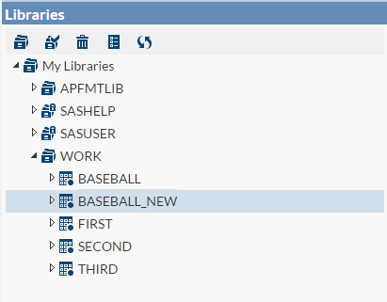
PROC Means – Output
Output Statement stores result in new data set. Here, the new data set is baseball_new.

Slide 44
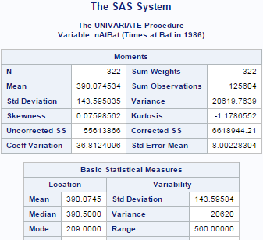

PROC Univariate
PROC UNIVARIATE
Examines distribution for numeric variables.
produces printed output by default
The following shows simplest use of PROC Univariate procedure.

Slide 45
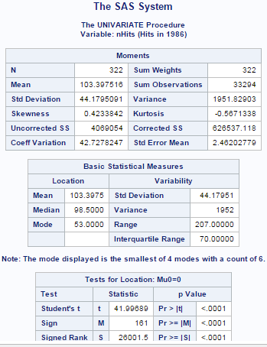
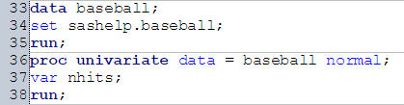
PROC Univariate – NORMAL
NORMAL Option requests for tests for normality that include a series of goodness-of-fit tests based on the empirical distribution function.

Slide 46
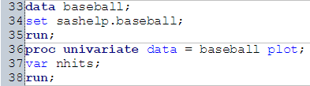
PROC Univariate – PLOT
PLOT Option in PROC Univariate produces a stem-and-leaf plot (or a horizontal bar chart), a box plot, and a normal quantile plot

Slide 47
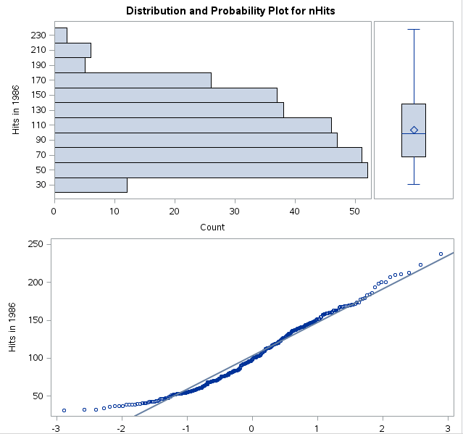
PROC Univariate – PLOT

Slide 48
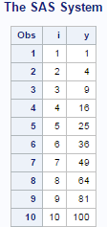
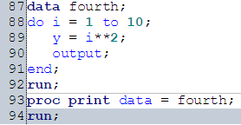
DO Loops

Slide 49


Incrementing Loop
Here the i is being incremented by 2 in the loop

Slide 50


Dropping Variable
Here, we create a dataset Sixth. We run a loop using a new variable i, but drop it so that it does not include in the dataset.

Slide 51


Decrementing Loop
Here the i is being decremented by 2 in the loop

Slide 52



Dataset using Raw file
Create a new folder in myfolders and call it mine.
Use libname statement to create a new SAS library called mine. How do we get the path of mine?

Slide 53

Dataset using Raw file
3. Upload diamonds.csv dataset into the mine folder
4. Check the folder

Slide 54

PROC Import
We use Proc IMPORT to import the dataset.
OUT Option specifies a name for SAS data set
DATAFILE Statement specifies the location/path of the uploaded file.
DBMS Statement indicates the type of uploaded file.
GETNAMES Statement tells SAS whether the first row of the data values is to be considered as variable names or not(Yes - if to be considered as variable names).

Slide 55


Dataset using Raw file
Check the MINE Library
Create a temporary data set called diamonds, using the existing data set.

Slide 56


PROC Corr
Correlation is one of the first steps to understand the relationship between variables. To compute correlation in SAS, we use PROC CORR.
Corr Procedure calculates pairwise correlation for Numeric variables. This procedure also provides some summary statistics by default - Mean, Standard Deviation, Sum, Minimum and Maximum.

Slide 57
Assignment
Make use of the procedures learnt in the class to compute statistics for diamonds data set.
https://vincentarelbundock.github.io/Rdatasets/csv/Ecdat/Diamond.csv

Slide 58

SAS DOCUMENTATION = Hallelujah!
http://support.sas.com/documentation/

Slide 59

PROC SQL
http://www2.sas.com/proceedings/sugi27/p191-27.pdf

Slide 60

PROC SQL
Use SQL within SAS

Slide 61


MACRO LANGUAGE
https://v8doc.sas.com/sashtml/macro/znemacro.htm

Slide 62
MACRO LANGUAGE

Slide 63

ODS
http://support.sas.com/rnd/base/ods/scratch/ods-tips.pdf

Slide 64

ODS
http://support.sas.com/rnd/base/ods/scratch/ods-tips.pdf

Slide 65

Data Visualization using SAS

Slide 66

Data Visualization using SAS

Slide 67
Data Visualization using SAS

Slide 68

Data Visualization using SAS
Use Tasks
see https://welcomedata.wordpress.com/2015/03/23/quick-pie-charts-in-sas-university-edition/

Slide 69

Modeling using SAS
proc reg data=sashelp.cars;
model MPG_City = Cylinders Weight ;
run;

Slide 70

Modeling using SAS
proc reg data=sashelp.cars;
model MPG_City = Cylinders Weight ;
run;

Slide 71

Modeling using SAS
proc reg data=sashelp.cars;
model MPG_City = Cylinders Weight ;
run;

Slide 72

Modeling using SAS
proc reg data=sashelp.cars;
model MPG_City = Cylinders Weight ;
run;

Slide 73
Modeling using SAS
Try this
proc reg data=sashelp.iris;
model SepalLength = SepalWidth PetalLength PetalWidth ;
run;
NOW TRY THIS
proc reg data=sashelp.iris;
model SepalLength = SepalWidth PetalLength PetalWidth /vif collin;
run;

Slide 74

Modeling using SAS : Multicollinearity
http://support.sas.com/documentation/cdl/en/statug/63033/HTML/default/viewer.htm#statug_reg_sect038.htm

Slide 75


Modeling using SAS : PROC LOGISTIC
proc logistic data=sashelp.Bmt;
class Group;
model Status=Group;
run;

Slide 76

Modeling using SAS : PROC LOGISTIC
proc logistic data=sashelp.Bmt;
class Group;
model Status=Group;
run;

Slide 77
Questions or Feedback
Email us at
info@decisionstats.org

Slide 78
Introduction to SAS

